Slide 1
Reduction of Total Monthly Incidents Project DMAIC
Business/Vertical/Account/Project/Division: RCTG/ORGP/ASM/WEE-10853-DE-MS2012
GB: Maria Emilia Soares
Team Members: João Luis Morais / Carla Miranda
BB: Arthur Valle
MBB: RAJALINGAM RAMAKRISHNAN
Champion: António Pedro Oliveira
Notes:
The below and following notes on the template slides are to guide you only. In your final presentation, you may delete these notes and add relevant notes if any.
Title slide:
Title – should not exceed beyond 3 lines, font size 30-34, Arial Bold
(Font size for the title of the PPT can vary between 30-34, Arial, Bold depending on the amount of text, however should not be smaller than 30 font size)
Name should not exceed beyond 1 line, Designation; font size to remain at 16, Arial normal
Please keep the title slide simple, just the logo, title and name and designation to appear. No other graphic elements or any design, photograph, image can be added to this slide, alignment to remain the same

Slide 2
Summary
D
M
A
I
C
D
Define
M
Measure
A
Analyze
I
Improve
C
Control
Notes:
Agenda slide:
Heading – Agenda - Font size 30, Arial Bold
Please restrict this slide with just 5 agenda points. If you have more than 5 points on the agenda slide please add another slide. If you have only 3 then you can use just one slide and delete the other 2 points.

Slide 3
Overview of the Process (1/2)
D
M
A
I
C
Provide the Big Picture of the Project
This DMAIC Project aims to reduce on WE Europe account (Managed Service – Fashion customer operating in Nertherlands, Belgium, Swiss, France, Austria, Germany and Luxembourg) the following:
Total Number of incidents (specially reduce the number of recurrent incidents on Warehouse Management System and Integration (RIB) System). Understand the root cause for the actual values.
Overview of the Process/Project
Service Operations gives application support and maintenance to the business applications such as ERP ORACLE (Retail Merchandise System, Warehouse Merchandise System, Retail Price Management, RIB Integration, Entrepot and Sonic (Customized business systems)). This service is provided 24h*7d.
The support agreement has been built around these key principles:
Wipro must provide continuous, effective support, from a knowledgeable team for the term of this agreement.
That the response and resolution to incidents are in line with the required service levels operated within We Fashion.
That the initial “base code” will become increasingly stable over time.
Notes:
Content Slide: This is usually the most frequently used slide in every presentation.
Use this slide for Text heavy slides. Text can only be used in bullet points
Title Heading – font size 30, Arial bold
Slide Content – Should not reduce beyond Arial font 16
If you need to use sub bullets please use the indent buttons located next to the bullets buttons in the tool bar and this will automatically provide you with the second, third, fourth & fifth level bullet styles and font sizes
Please note you can also press the tab key to create the different levels of bulleted content

Slide 4
Overview of the Process (2/2)
D
M
A
I
C
Link it very Clearly to End Customer
Customer will receive the solution to this reduction request (reduction of contact value by reducing the on-call cost and also be more proactive and be more focus in the recurrent incidents).
Reduction of Total Number of Incidents
+ Business Results:
+ Customer Satisfaction
More Availability;
Team size optimization;
Reduce backlog size;
Reduce on-call costs;
Increase CSAT results.
Focus of the Project:
Lower monthly contract value (renewal);
ASM team focus on continual improvement
Notes:
Content Slide: This is usually the most frequently used slide in every presentation.
Use this slide for Text heavy slides. Text can only be used in bullet points
Title Heading – font size 30, Arial bold
Slide Content – Should not reduce beyond Arial font 16
If you need to use sub bullets please use the indent buttons located next to the bullets buttons in the tool bar and this will automatically provide you with the second, third, fourth & fifth level bullet styles and font sizes
Please note you can also press the tab key to create the different levels of bulleted content

Slide 5
Voice of Customer
D
M
A
I
C
Notes:
Content Slide: This is usually the most frequently used slide in every presentation.
Use this slide for Text heavy slides. Text can only be used in bullet points
Title Heading – font size 30, Arial bold
Slide Content – Should not reduce beyond Arial font 16
If you need to use sub bullets please use the indent buttons located next to the bullets buttons in the tool bar and this will automatically provide you with the second, third, fourth & fifth level bullet styles and font sizes
Please note you can also press the tab key to create the different levels of bulleted content

Slide 6
Project Charter
D
M
A
I
C
Notes:
Content Slide: This is usually the most frequently used slide in every presentation.
Use this slide for Text heavy slides. Text can only be used in bullet points
Title Heading – font size 30, Arial bold
Slide Content – Should not reduce beyond Arial font 16
If you need to use sub bullets please use the indent buttons located next to the bullets buttons in the tool bar and this will automatically provide you with the second, third, fourth & fifth level bullet styles and font sizes
Please note you can also press the tab key to create the different levels of bulleted content

Slide 7
CTQ Drill-down (Total Number of Incidents)
D
M
A
I
C
Monthly Incidents
Customer CTQ
Business CTQs
Backlog Incidents
New Incidents
Reduce 25% from total incident raised in average/month
Project CTQ
Notes:
Display the slide.
Explain that using CTQ drill down with supporting data helps in choosing the internal CTQ which has maximum impact on customer / Business CTQ. This tools prevents teams wasting effort on trivials which may not have much impact on the customer/ Business CTQ.

Slide 8
As-is Process Mapping
D
M
A
I
C
Incident Process
Notes:
Content Slide: This is usually the most frequently used slide in every presentation.
Use this slide for Text heavy slides. Text can only be used in bullet points
Title Heading – font size 30, Arial bold
Slide Content – Should not reduce beyond Arial font 16
If you need to use sub bullets please use the indent buttons located next to the bullets buttons in the tool bar and this will automatically provide you with the second, third, fourth & fifth level bullet styles and font sizes
Please note you can also press the tab key to create the different levels of bulleted content

Slide 9
Project Scope
D
M
A
I
C
Longitudinal:
Incident/Problem Management process for WE
Lateral:
Service Operations:
WMS
INT
It will be excluded from this project scope the Service Request tickets and the issues caused by recent CR implementations.
Notes:
Content Slide: This is usually the most frequently used slide in every presentation.
Use this slide for Text heavy slides. Text can only be used in bullet points
Title Heading – font size 30, Arial bold
Slide Content – Should not reduce beyond Arial font 16
If you need to use sub bullets please use the indent buttons located next to the bullets buttons in the tool bar and this will automatically provide you with the second, third, fourth & fifth level bullet styles and font sizes
Please note you can also press the tab key to create the different levels of bulleted content

Slide 10
Define Phase Check Points
D
M
A
I
C
VOC : Captured from customers / stakeholders inputs and the project CTQ is in line with the inputs from VOC
Project Charter : Project CTQ is linked with Business / Customer Expectations
There are serious ramifications if the project is not done / not done now !
Problem Statement reflects the measures, magnitude of problem and also the impact of the same.
SIPOC (Process Mapping) : Clearly depicts the linkage between end customer and the suppliers and the detailed sub processes.
Leadership Commitment : Champion and other account leadership approved the scope of the project
CTQs (Y): Projects CTQ is clearly identified and measured. There are adequate number of data points (At least 10) for the identified CTQ
Benefits : Project benefits estimated using appropriate method and Financial calculations are validated with BFM. Desired annualized benefit for a BB project is USD 250k and for GB Project is USD 100k
Milestones : Milestones are defined properly and there is enough time between Improve and Control to ensure the CTQ is in control.
Notes:
Content Slide: This is usually the most frequently used slide in every presentation.
Use this slide for Text heavy slides. Text can only be used in bullet points
Title Heading – font size 30, Arial bold
Slide Content – Should not reduce beyond Arial font 16
If you need to use sub bullets please use the indent buttons located next to the bullets buttons in the tool bar and this will automatically provide you with the second, third, fourth & fifth level bullet styles and font sizes
Please note you can also press the tab key to create the different levels of bulleted content

Slide 11
CTQ Characteristics
D
M
A
I
C
Operational Definition of Project CTQ (Y):
Reduce the number of total incidents raised every month. The goal is reducing the number of incidents in 25%.
Y/M | 2014-01 | 2014-02 | 2014-03 | 2014-04 | 2014-05 | 2014-06 | 2014-07 | 2014-08 | 2014-09 | 2014-10 | 2014-11 | 2014-12 | 2015-01 | 2015-02 | 2015-03 | 2015-04 | 2015-05 | 2015-06 | 2015-07 | 2015-08 | 2015-09
# Tickets | 59 | 62 | 50 | 28 | 41 | 45 | 48 | 36 | 72 | 55 | 63 | 59 | 74 | 71 | 56 | 46 | 45 | 59 | 57 | 58 | 41
CTQ | Describe Your measure | Frequency of Data collection | Type of data Discrete/Cont | Target | Upper Spec | Lower Spec
Total Incidents | Count of number of incidents raised in TopDesk tool. | Monthly | Cont. | 40 | 50 | 0
Notes:
Content Slide: This is usually the most frequently used slide in every presentation.
Use this slide for Text heavy slides. Text can only be used in bullet points
Title Heading – font size 30, Arial bold
Slide Content – Should not reduce beyond Arial font 16
If you need to use sub bullets please use the indent buttons located next to the bullets buttons in the tool bar and this will automatically provide you with the second, third, fourth & fifth level bullet styles and font sizes
Please note you can also press the tab key to create the different levels of bulleted content

Slide 12
Data Collection Plan
D
M
A
I
C
What is the source (Measurement System) for collecting the Data?
TopDesk tool
How many Data points are Required
Data extracted monthly from TopDesk tool. The extraction is done for an excel sheet and then it is validated based on predefined calculations formulas setup in the beginning of the project.
What is the Sampling technique used if any?
Not Applicable - Data from population will be considered;
Which period data is collected?
Data collected since January 2014 until September 2015 November 2015.
Notes:
Content Slide: This is usually the most frequently used slide in every presentation.
Use this slide for Text heavy slides. Text can only be used in bullet points
Title Heading – font size 30, Arial bold
Slide Content – Should not reduce beyond Arial font 16
If you need to use sub bullets please use the indent buttons located next to the bullets buttons in the tool bar and this will automatically provide you with the second, third, fourth & fifth level bullet styles and font sizes
Please note you can also press the tab key to create the different levels of bulleted content

Slide 13
Measurement System Validation
D
M
A
I
C
What technique is adopted for validating the Measurement System?
Data was taken from a system and the source of most data is not a manual input or influenced by human intervention. So, a formal MSA was not conducted. However, some validations were done in a random basis, such as:
Compare values with previous months to validate discrepancies.
Validate if number of incidents recorded in the tool are coherent.
Validate if there are resources allocated for a queue for which they are not supposed to be assigned.
What’s the Resolution, Accuracy and GRR as a % of contribution / part-to-part?
N/A. A formal MSA was not conducted.
If it is not acceptable as per criteria, action plan?
N/A. A formal MSA was not conducted.
After the implementation of action plan, improved level of GRR%, Accuracy?
N/A. A formal MSA was not conducted.
After extract the data from topdesk to the control excel sheet the same is validated in order to ensure that all incidents raised on that month are being considered.
Notes:
Content Slide: This is usually the most frequently used slide in every presentation.
Use this slide for Text heavy slides. Text can only be used in bullet points
Title Heading – font size 30, Arial bold
Slide Content – Should not reduce beyond Arial font 16
If you need to use sub bullets please use the indent buttons located next to the bullets buttons in the tool bar and this will automatically provide you with the second, third, fourth & fifth level bullet styles and font sizes
Please note you can also press the tab key to create the different levels of bulleted content

Slide 14
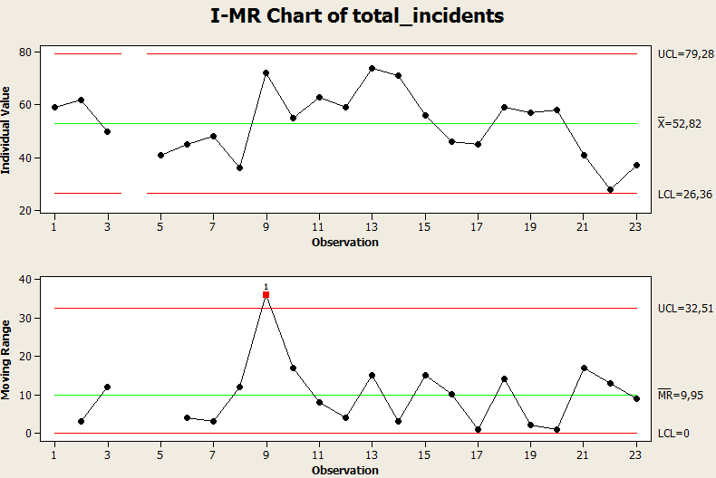
Updated to cover until Nov/2015
Data Analysis
D
M
A
I
C
For this analysis have been collected the incidents raised on TopDesk since January/2014 till November/2015.
Below graphic is displaying the monthly variance.
Notes:
Content Slide: This is usually the most frequently used slide in every presentation.
Use this slide for Text heavy slides. Text can only be used in bullet points
Title Heading – font size 30, Arial bold
Slide Content – Should not reduce beyond Arial font 16
If you need to use sub bullets please use the indent buttons located next to the bullets buttons in the tool bar and this will automatically provide you with the second, third, fourth & fifth level bullet styles and font sizes
Please note you can also press the tab key to create the different levels of bulleted content

Slide 15
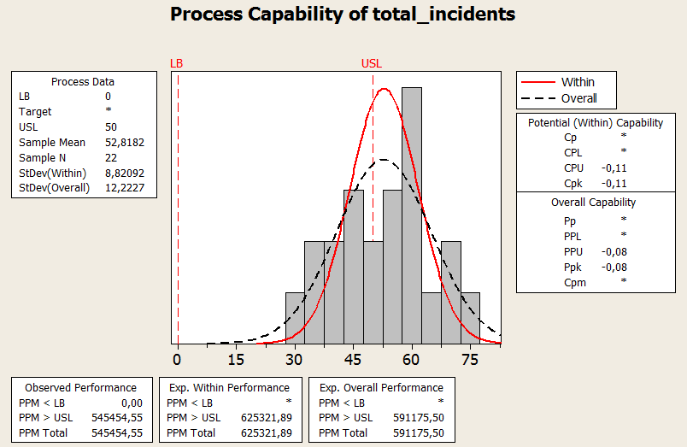
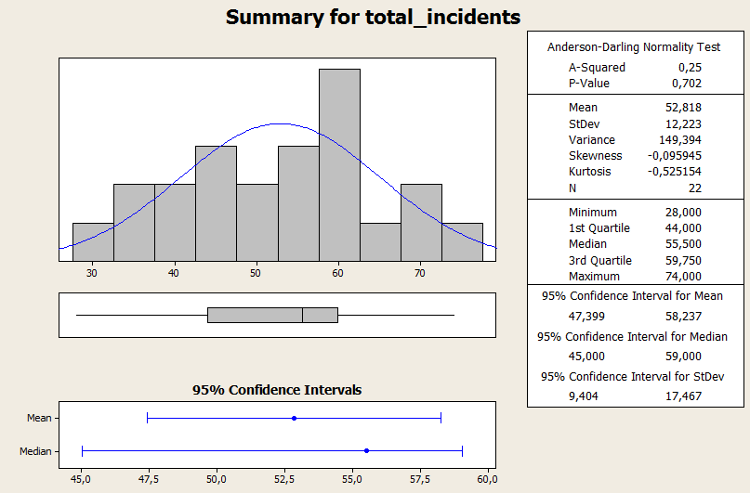
Updated to cover until Nov/2015
Process Baseline
D
M
A
I
C
CTQ | Describe Your measure | Frequency of Data collection | Type of data Discrete/Cont | Target | Upper Spec | Lower Spec
Total Incidents | Count of number of incidents raised in TopDesk tool. | Monthly | Cont. | 40 | 50 | 0
Notes:
Content Slide: This is usually the most frequently used slide in every presentation.
Use this slide for Text heavy slides. Text can only be used in bullet points
Title Heading – font size 30, Arial bold
Slide Content – Should not reduce beyond Arial font 16
If you need to use sub bullets please use the indent buttons located next to the bullets buttons in the tool bar and this will automatically provide you with the second, third, fourth & fifth level bullet styles and font sizes
Please note you can also press the tab key to create the different levels of bulleted content

Slide 16
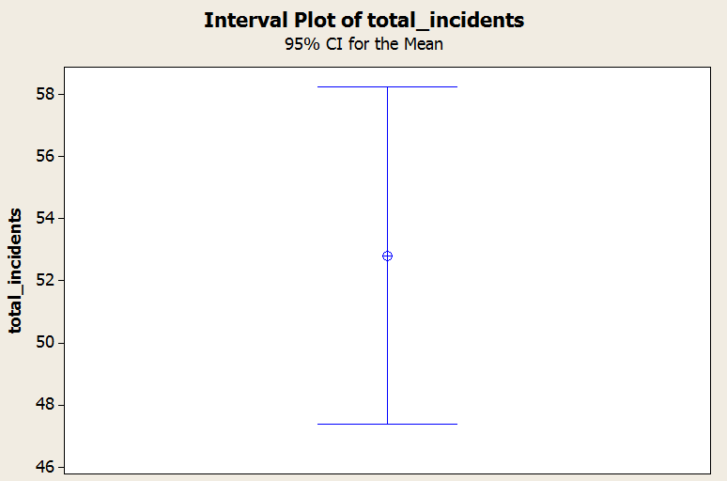
Updated to cover until Nov/2015
Process Improvement Target
D
M
A
I
C
Continuous Data Type:
Target: moving from a mean of 52.18 and control interval of (26.36; 79.28) to a mean of 40.0 and control interval of (0.0; 50.0).
Statistical significance of improved state (hypothesis testing): moving to a mean of 40.00 (and 8.33 as standard-deviation) will lead to a significant improved state (as per hypothesis test and interval plot below).
Test and CI for One Variance: total_incidents
Method
Null hypothesis Sigma = 8,33
Alternative hypothesis Sigma not = 8,33
The chi-square method is only for the normal distribution.
The Bonett method is for any continuous distribution.
Statistics
Variable N StDev Variance
total_incidents 22 12,2 149
95% Confidence Intervals
CI for CI for
Variable Method StDev Variance
total_incidents Chi-Square (9,4; 17,5) (88; 305)
Bonett (9,6; 17,0) (93; 289)
One-Sample T: total_incidents
Test of mu = 40 vs not = 40
Variable N Mean StDev SE Mean 95% CI T P
total_incidents 22 52,82 12,22 2,61 (47,40; 58,24) 4,92 0,000
Notes:
Content Slide: This is usually the most frequently used slide in every presentation.
Use this slide for Text heavy slides. Text can only be used in bullet points
Title Heading – font size 30, Arial bold
Slide Content – Should not reduce beyond Arial font 16
If you need to use sub bullets please use the indent buttons located next to the bullets buttons in the tool bar and this will automatically provide you with the second, third, fourth & fifth level bullet styles and font sizes
Please note you can also press the tab key to create the different levels of bulleted content

Slide 17
Measure Phase Check Points
D
M
A
I
C
Operational definition of the CTQs are established – Clear and non ambiguous way of computing the CTQ along with the unit of measurement.
Specification limits (USL and LSL) and targets are clearly illustrated
Defect definition is clear and non ambiguous and is in line with the project objective and customer expectation (Specification Limits)
Data type for the CTQ (Continuous/Discrete) is correctly identified. For example % defective isn’t continuous and has to be discrete
Detailed data collection plan is devised and data is collected accordingly. Time period of data collection (Frequency( is appropriate enough to collect adequate sample size.
Measurement System Analysis (MSA): MSA is conducted on the CTQs. If the data is taken from a system and if the source of that data is a manual input or influenced by human intervention then validate the reliability of measurements.
Notes:
Content Slide: This is usually the most frequently used slide in every presentation.
Use this slide for Text heavy slides. Text can only be used in bullet points
Title Heading – font size 30, Arial bold
Slide Content – Should not reduce beyond Arial font 16
If you need to use sub bullets please use the indent buttons located next to the bullets buttons in the tool bar and this will automatically provide you with the second, third, fourth & fifth level bullet styles and font sizes
Please note you can also press the tab key to create the different levels of bulleted content

Slide 18
Measure Phase Check Points
D
M
A
I
C
Data Stability (Run Chart) assessed before computing the process capability. If the process is not stable the appropriate actions are taken to stabilize the process before proceeding with the analysis.
Normality check of the data. If the data is not normal, distribution type is identified and appropriate non normal strategy used to baseline the data and to set up improvement targets
Process Capability is computed and the Z bench (Baseline Sigma value) and DMPO clearly documented. For discrete data Sigma value computed using 6 Sigma calculator.
Validation of the Target Targets are statistically validated using appropriate statistical tools, All baseline analysis are conducted with the same baseline data. Same data used for stability, normality, process capability and target validation.
Notes:
Content Slide: This is usually the most frequently used slide in every presentation.
Use this slide for Text heavy slides. Text can only be used in bullet points
Title Heading – font size 30, Arial bold
Slide Content – Should not reduce beyond Arial font 16
If you need to use sub bullets please use the indent buttons located next to the bullets buttons in the tool bar and this will automatically provide you with the second, third, fourth & fifth level bullet styles and font sizes
Please note you can also press the tab key to create the different levels of bulleted content

Slide 19
List of Xs
D
M
A
I
C
Fishbone Diagram
X1
X2
X3
X8
X4
X5
X6
X7
X9
Notes:
Content Slide: This is usually the most frequently used slide in every presentation.
Use this slide for Text heavy slides. Text can only be used in bullet points
Title Heading – font size 30, Arial bold
Slide Content – Should not reduce beyond Arial font 16
If you need to use sub bullets please use the indent buttons located next to the bullets buttons in the tool bar and this will automatically provide you with the second, third, fourth & fifth level bullet styles and font sizes
Please note you can also press the tab key to create the different levels of bulleted content

Slide 20
Prioritized Xs
D
M
A
I
C
Finding X’s:
X’s | Description
X1 | Service Requests raised on TopDesk tool as Incidents
X2 | Recurrent Incidents
X3 | Invalid data from other systems or user mistakes
X4 | Unknown releases in customer systems
X5 | Business special dates
X6 | Team rotation
X7 | Infraestructure failures
X8 | New system users
X9 | Customer organization structure change
Project team analysed above causes and decided about the ones with more impact in our project. The results are displayed on below table:
Notes:
Content Slide: This is usually the most frequently used slide in every presentation.
Use this slide for Text heavy slides. Text can only be used in bullet points
Title Heading – font size 30, Arial bold
Slide Content – Should not reduce beyond Arial font 16
If you need to use sub bullets please use the indent buttons located next to the bullets buttons in the tool bar and this will automatically provide you with the second, third, fourth & fifth level bullet styles and font sizes
Please note you can also press the tab key to create the different levels of bulleted content

Slide 21
Prioritized Xs
D
M
A
I
C
Reference Table
X’s | Description | Prioritization | Control
X1 | Service Requests raised on TopDesk tool as Incidents | 4 | Y
X2 | Recurrent Incidents | 3 | Y
X3 | Invalid data from other systems or user mistakes | 2 | Y
X4 | Unknown releases in customer systems | 2 | N
X5 | Business special dates | 1 | N
X6 | Team rotation | 2 | N
X7 | Infraestructure failures | 1 | N
X8 | New system users | 1 | N
X9 | Customer organization structure change | 1 | N
Notes:
Content Slide: This is usually the most frequently used slide in every presentation.
Use this slide for Text heavy slides. Text can only be used in bullet points
Title Heading – font size 30, Arial bold
Slide Content – Should not reduce beyond Arial font 16
If you need to use sub bullets please use the indent buttons located next to the bullets buttons in the tool bar and this will automatically provide you with the second, third, fourth & fifth level bullet styles and font sizes
Please note you can also press the tab key to create the different levels of bulleted content

Slide 22
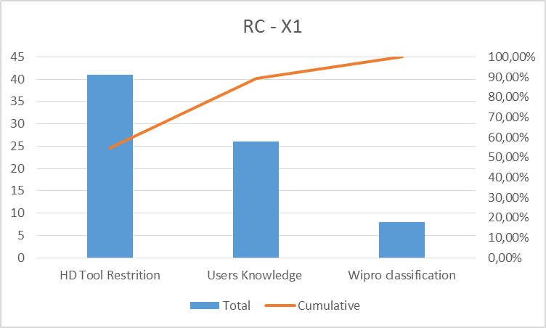
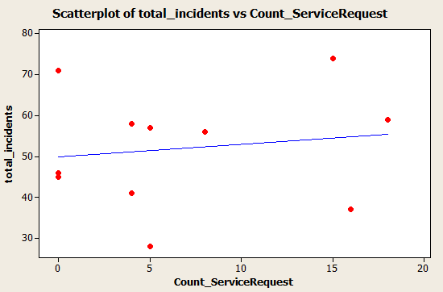
Prioritized Xs
D
M
A
I
C
Data extraction
x1: Service Requests raised on TopDesk tool as Incidents
HD Tool Restrition – Help Desk tool not allows to introduce all types of SR’s.
User Knowledge – it is easiest for customer users raise incidents than SR’s.
Wipro classification - Bad classification provided by Wipro during the ticket update.
Notes:
Content Slide: This is usually the most frequently used slide in every presentation.
Use this slide for Text heavy slides. Text can only be used in bullet points
Title Heading – font size 30, Arial bold
Slide Content – Should not reduce beyond Arial font 16
If you need to use sub bullets please use the indent buttons located next to the bullets buttons in the tool bar and this will automatically provide you with the second, third, fourth & fifth level bullet styles and font sizes
Please note you can also press the tab key to create the different levels of bulleted content

Slide 23
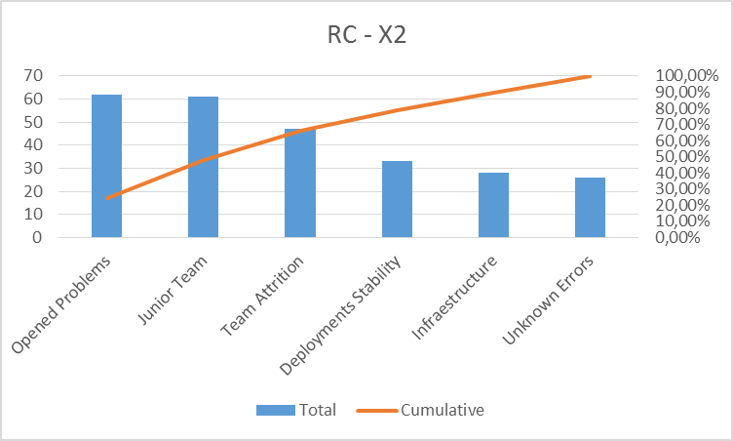
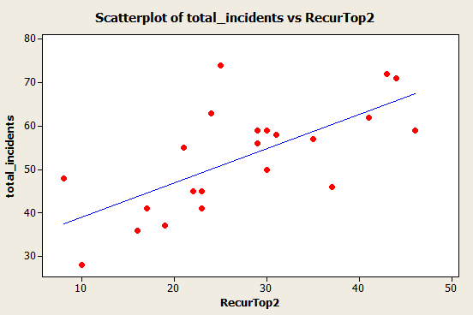
Prioritized Xs
D
M
A
I
C
Data extraction
x2: Recurrent Incidents
Opened Problems – Old problems still open.
Junior Team – Wipro support team is very junior.
Team attrition – Resources leaving from Wipro or moving to other projects.
Deployments stability – Errors occurred after new deployments.
Infraesructure – Failures due to network issues.
Unknown Errors – Random errors.
Correlations: total_incidents; RecurTop2
Pearson correlation of total_incidents and RecurTop2 = 0,683
P-Value = 0,000
Notes:
Content Slide: This is usually the most frequently used slide in every presentation.
Use this slide for Text heavy slides. Text can only be used in bullet points
Title Heading – font size 30, Arial bold
Slide Content – Should not reduce beyond Arial font 16
If you need to use sub bullets please use the indent buttons located next to the bullets buttons in the tool bar and this will automatically provide you with the second, third, fourth & fifth level bullet styles and font sizes
Please note you can also press the tab key to create the different levels of bulleted content

Slide 24
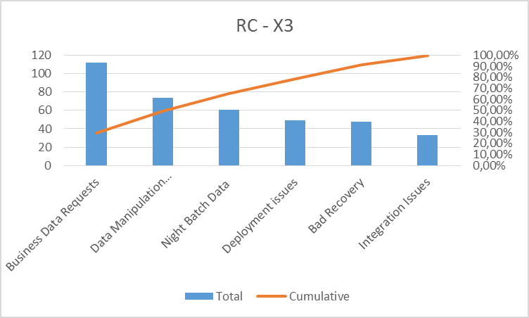
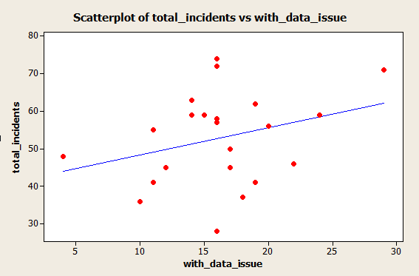
Prioritized Xs
D
M
A
I
C
Data extraction
x3: Invalid data from other systems or user mistakes
Correlations: total_incidents; with_data_issue
Pearson correlation of total_incidents and with_data_issue = 0,306
P-Value = 0,166
Business Data Requests – Inserts/Updates requested by business users.
Data Manipulation Issues - Errors caused by data manipulations.
Night batch Data – Data issues caused by night batch.
Deployments issues - Data issues caused by new deployments.
Bad Recovery - Data issues caused incorrect recovery process errors.
Integration Issues – Incorrect data received from external servers.
Notes:
Content Slide: This is usually the most frequently used slide in every presentation.
Use this slide for Text heavy slides. Text can only be used in bullet points
Title Heading – font size 30, Arial bold
Slide Content – Should not reduce beyond Arial font 16
If you need to use sub bullets please use the indent buttons located next to the bullets buttons in the tool bar and this will automatically provide you with the second, third, fourth & fifth level bullet styles and font sizes
Please note you can also press the tab key to create the different levels of bulleted content

Slide 25
Description of Prioritized Xs
D
M
A
I
C
x1: Service Requests and Incidents were raised in the Service Desk tool without distinction.
x2: Weight of Recurrent incidents in the total monthly value.
x3: Invalid data from other systems or user mistakes.
Prioritized X | Description | Why? 1 | Why? 2 | Why? 3 | Why? 4 | Why? 5
X1 | Service Requests raised as Incidents | Why are SR’s raised as Incidents? A: Tool not prepared | Why Helpdesk tool is not displaying SR’s? A: Not setup | Why the SR´s is not configured in the tool A: It was never requested | Why this issue has not been managed before? A: Customer IT team structure.
X2 | Recurrent Incidents | Why are occurring recurrent incidents every month? A: problems not fixed | Why recurrent incidents are not having a RCA defined? A: Project with Junior team | Why project is having a junior team? A: It is a small project | Why a small project could not allocate experienced resources? A: Budget project is not enough | Why project does not assign expert resources to help in the analysis of critical problems? A. It was already done-
X3 | Invalid Data | Why data issues are occurring? A: Several manual data manipulations are requested be customer. | Why data manipulations are requesated? A: Customer upload bulks of data. | Why Bulks of data are uploaded manually? A: Does not exists a tool to upload it. | Why a tool is not available? A: It is not a base functionality. Wipro is creating it.
Notes:
Content Slide: This is usually the most frequently used slide in every presentation.
Use this slide for Text heavy slides. Text can only be used in bullet points
Title Heading – font size 30, Arial bold
Slide Content – Should not reduce beyond Arial font 16
If you need to use sub bullets please use the indent buttons located next to the bullets buttons in the tool bar and this will automatically provide you with the second, third, fourth & fifth level bullet styles and font sizes
Please note you can also press the tab key to create the different levels of bulleted content

Slide 26
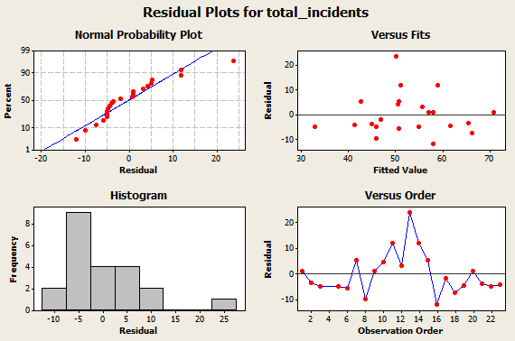
Transfer equation Y=f(x)
D
M
A
I
C
Y = 37,5 + 1,15 x2 - 1,00 x3
Regression Analysis: total_incidents versus RecurTop2; with_data_issue
The regression equation is
total_incidents = 37,5 + 1,15 RecurTop2 - 1,00 with_data_issue
22 cases used, 1 cases contain missing values
Predictor Coef SE Coef T P
Constant 37,508 6,220 6,03 0,000
RecurTop2 1,1504 0,2626 4,38 0,000
with_data_issue -1,0024 0,5359 -1,87 0,077
S = 8,62945 R-Sq = 54,9% R-Sq(adj) = 50,2%
Notes:
Content Slide: This is usually the most frequently used slide in every presentation.
Use this slide for Text heavy slides. Text can only be used in bullet points
Title Heading – font size 30, Arial bold
Slide Content – Should not reduce beyond Arial font 16
If you need to use sub bullets please use the indent buttons located next to the bullets buttons in the tool bar and this will automatically provide you with the second, third, fourth & fifth level bullet styles and font sizes
Please note you can also press the tab key to create the different levels of bulleted content

Slide 27
Analyze Phase Check Points
D
M
A
I
C
Root causes are identified using appropriate 6 Sigma tools like Fishbone or other tools & Identified X’s are independent and measurable.
Data collected for X’s that has been identified to perform statistical analysis to check their impact on Y
Prioritization of X’s All the X’s identified are validated using statistical tools to check their impact on Y (Pareto and other excel based descriptive analysis is ok however the belt should perform appropriate statistical tests (Ex: Regression, Hypothesis testing) to check if that X is significantly impacting the Y)
Transfer function (Regression Equation) derived to check the relation between X’s and Y.
Identification using non Statistical tools: X’s for which data collection is difficult or data is not available were Prioritized using non statistical tools like multi-voting or control impact matrix. (This should not be the only tool to prioritize critical X’s and this should be used in conjunction with statistical tools)
Notes:
Content Slide: This is usually the most frequently used slide in every presentation.
Use this slide for Text heavy slides. Text can only be used in bullet points
Title Heading – font size 30, Arial bold
Slide Content – Should not reduce beyond Arial font 16
If you need to use sub bullets please use the indent buttons located next to the bullets buttons in the tool bar and this will automatically provide you with the second, third, fourth & fifth level bullet styles and font sizes
Please note you can also press the tab key to create the different levels of bulleted content

Slide 28
Relationship between Y and Xs
D
M
A
I
C
Update this slide if you have used DOE
DOE Design Matrix
DOE Analysis
Main Effects/Interaction Effects Plots
Transfer Function
Notes:
Content Slide: This is usually the most frequently used slide in every presentation.
Use this slide for Text heavy slides. Text can only be used in bullet points
Title Heading – font size 30, Arial bold
Slide Content – Should not reduce beyond Arial font 16
If you need to use sub bullets please use the indent buttons located next to the bullets buttons in the tool bar and this will automatically provide you with the second, third, fourth & fifth level bullet styles and font sizes
Please note you can also press the tab key to create the different levels of bulleted content

Slide 29
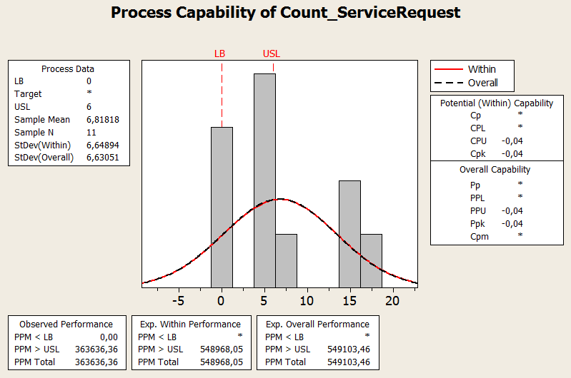
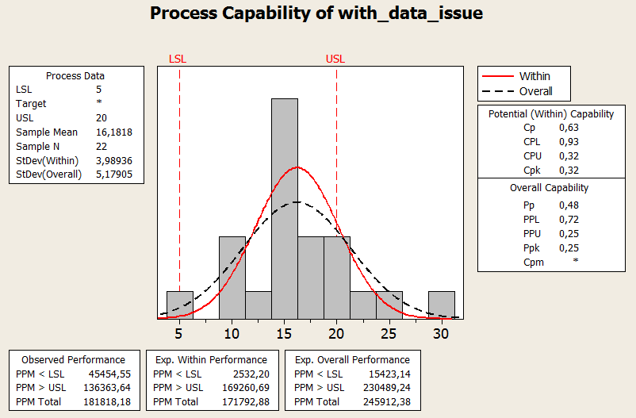
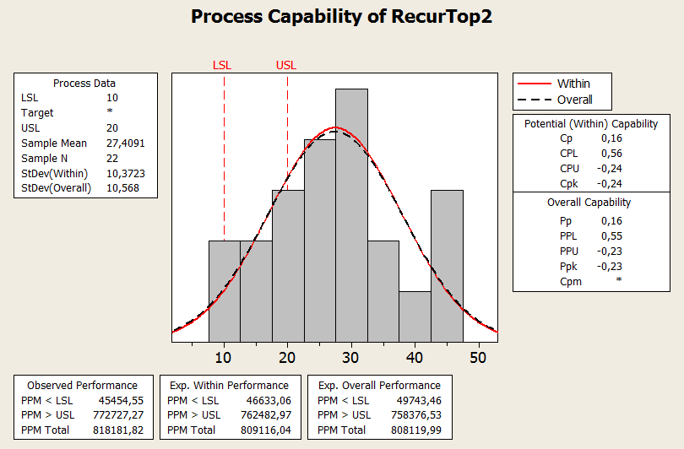
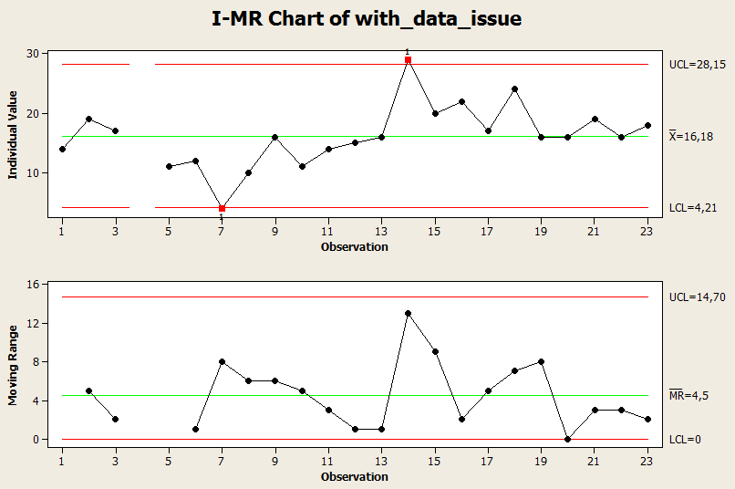
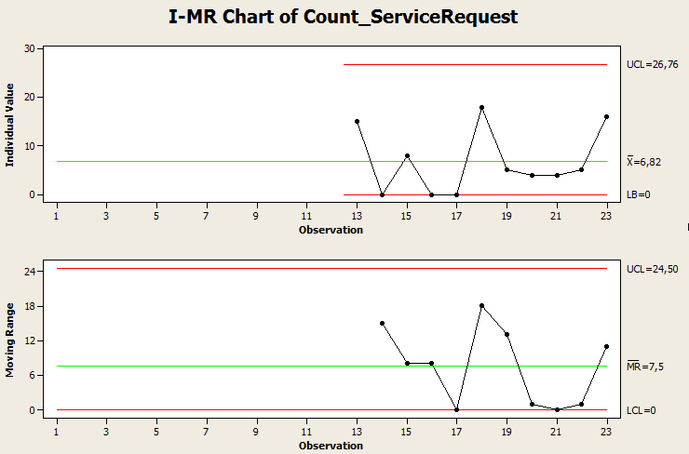
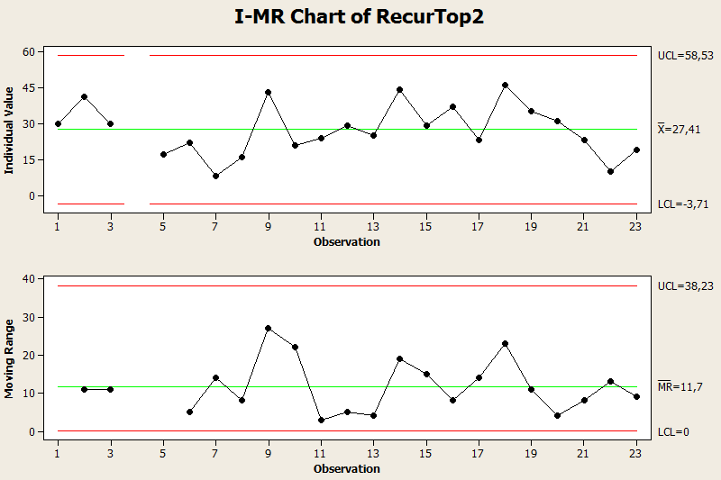
Baselines for X’s
D
M
A
I
C
X2-Recurrent tickets
X3-ticket with data issues
X1-Service Requests
Notes:
Content Slide: This is usually the most frequently used slide in every presentation.
Use this slide for Text heavy slides. Text can only be used in bullet points
Title Heading – font size 30, Arial bold
Slide Content – Should not reduce beyond Arial font 16
If you need to use sub bullets please use the indent buttons located next to the bullets buttons in the tool bar and this will automatically provide you with the second, third, fourth & fifth level bullet styles and font sizes
Please note you can also press the tab key to create the different levels of bulleted content

Slide 30
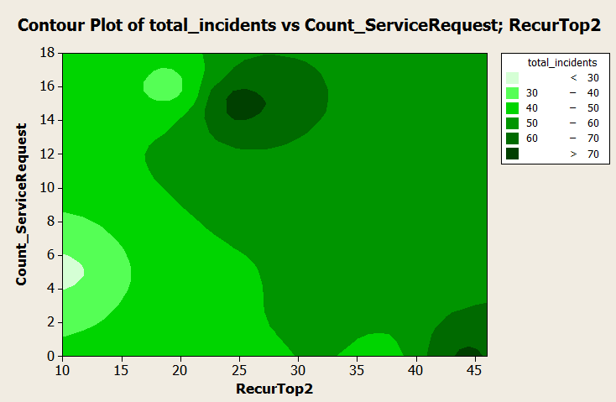
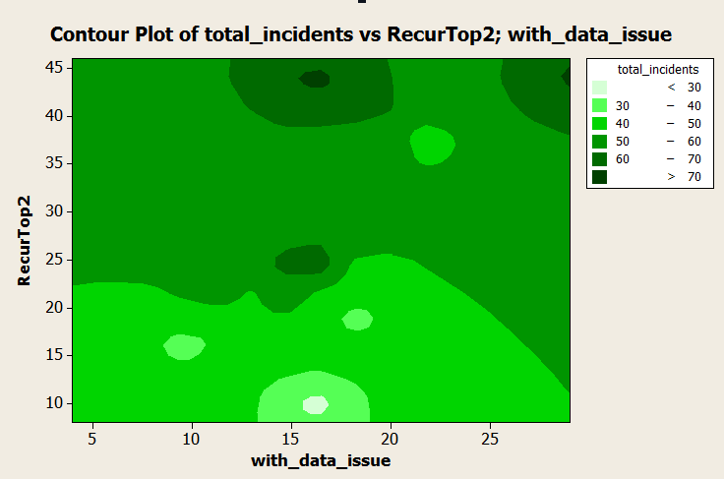
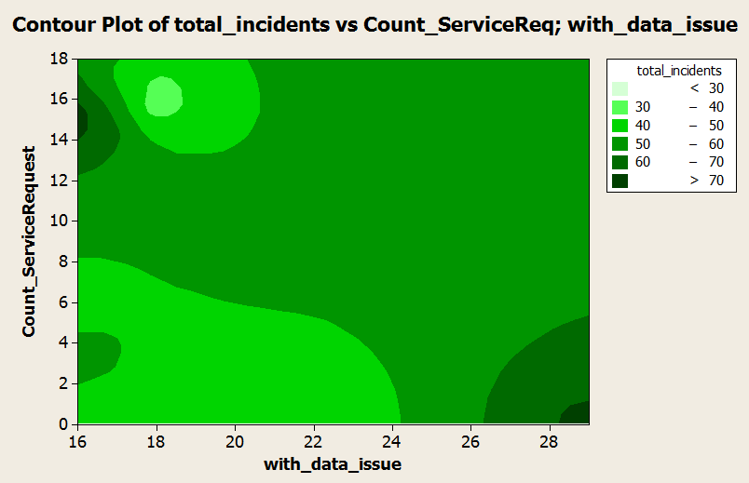
Operating Range for X’s
D
M
A
I
C
Tolerances on X’s:
x1 (0 to 6); x2 (10 to 20); x3 (5 to 20)
X1-Service Requests
X3-ticket with data issues
X2-Recurrent tickets
Notes:
Content Slide: This is usually the most frequently used slide in every presentation.
Use this slide for Text heavy slides. Text can only be used in bullet points
Title Heading – font size 30, Arial bold
Slide Content – Should not reduce beyond Arial font 16
If you need to use sub bullets please use the indent buttons located next to the bullets buttons in the tool bar and this will automatically provide you with the second, third, fourth & fifth level bullet styles and font sizes
Please note you can also press the tab key to create the different levels of bulleted content

Slide 31
Counter Measures for Xs
D
M
A
I
C
Root Cause | Counter Measures | Feasibility | Acceptability | Effectiveness | Score
X1-Service Requests | Customize the HD tool to split Incidents and SR’s | 1-High | 1-High | 1-High | 1
 | End users clarifications about Incidents and SR’s | 1-High | 1-High | 1-High | 1
 | Wipro support team to classify each call correctly | 2-Medium | 2-Medium | 2-Medium | 2
X2-Recurrent incidents | Proactive Problem Management in place | 1-High | 1-High | 1-High | 1
 | Increase team seniority | 2-Medium | 2-Medium | 1-High | 2
 | Address infrastructure failures causes | 2-Medium | 3-Low | 2-Medium | 3
X3-Incident with data issues | Create tools to automatize and validate business requests | 1-High | 1-High | 2-Medium | 1
 | Process to review the scripts used to upload bulks of data requested by customer | 1-High | 1-High | 1-High | 1
 | More details in test scripts in order to prevent data issues after a deployment | 1-High | 1-High | 1-High | 1
Notes:
Content Slide: This is usually the most frequently used slide in every presentation.
Use this slide for Text heavy slides. Text can only be used in bullet points
Title Heading – font size 30, Arial bold
Slide Content – Should not reduce beyond Arial font 16
If you need to use sub bullets please use the indent buttons located next to the bullets buttons in the tool bar and this will automatically provide you with the second, third, fourth & fifth level bullet styles and font sizes
Please note you can also press the tab key to create the different levels of bulleted content

Slide 32
Improved Process
D
M
A
I
C
SR’s are visible on TopDesk
Proactive Problem Management process
On-Call cost reduced in 35% (merged resources).
New tools to reduce data manipulations
Notes:
Content Slide: This is usually the most frequently used slide in every presentation.
Use this slide for Text heavy slides. Text can only be used in bullet points
Title Heading – font size 30, Arial bold
Slide Content – Should not reduce beyond Arial font 16
If you need to use sub bullets please use the indent buttons located next to the bullets buttons in the tool bar and this will automatically provide you with the second, third, fourth & fifth level bullet styles and font sizes
Please note you can also press the tab key to create the different levels of bulleted content

Slide 33
Improve Phase Check Points
D
M
A
I
C
Optimal settings for critical X’s identified along with allowable tolerances, Excel Solver is used for deriving best settings of X’s.
Counter measures matrix is prepared for all the prioritized X’s and ensure that all the actions cater to the significant X’s, Explored more than one solutions and rationally selected best solution.
Traceability exists between the improvement solutions and the critical X’s
To-Be process map (New process) is plotted and is consistent with solutions for significant X’s and as-is process map. Highlight the Modified/New process elements introduced
FMEA is done on the New process and the failure modes are mitigated or contingency actions are planned
Validate the improve actions yielded desired results, meeting the goals
Notes:
Content Slide: This is usually the most frequently used slide in every presentation.
Use this slide for Text heavy slides. Text can only be used in bullet points
Title Heading – font size 30, Arial bold
Slide Content – Should not reduce beyond Arial font 16
If you need to use sub bullets please use the indent buttons located next to the bullets buttons in the tool bar and this will automatically provide you with the second, third, fourth & fifth level bullet styles and font sizes
Please note you can also press the tab key to create the different levels of bulleted content

Slide 34
Measurement System Validation on Xs
D
M
A
I
C
What’s the GRR% on X’s?
They are the same, since method for extracting and calculating haven´t changed.
If it is not acceptable as per criteria, action plan?
N/A
After the implementation of action plan, reduced level of GRR%?
N/A
Notes:
Content Slide: This is usually the most frequently used slide in every presentation.
Use this slide for Text heavy slides. Text can only be used in bullet points
Title Heading – font size 30, Arial bold
Slide Content – Should not reduce beyond Arial font 16
If you need to use sub bullets please use the indent buttons located next to the bullets buttons in the tool bar and this will automatically provide you with the second, third, fourth & fifth level bullet styles and font sizes
Please note you can also press the tab key to create the different levels of bulleted content

Slide 35
New Process Performance
D
M
A
I
C
Data Analysis for the Improved process
Refer to next 2 steps
DPMO work-sheet for discrete data / Capability analysis for continuous data
Refer to next 2 steps, as well as “Before and After Summary” slide, with capability analysis and improvement rates
New process sigma multiple
Refer to “Before and After Summary” slide. With sigma calculation
Notes:
Content Slide: This is usually the most frequently used slide in every presentation.
Use this slide for Text heavy slides. Text can only be used in bullet points
Title Heading – font size 30, Arial bold
Slide Content – Should not reduce beyond Arial font 16
If you need to use sub bullets please use the indent buttons located next to the bullets buttons in the tool bar and this will automatically provide you with the second, third, fourth & fifth level bullet styles and font sizes
Please note you can also press the tab key to create the different levels of bulleted content

Slide 36
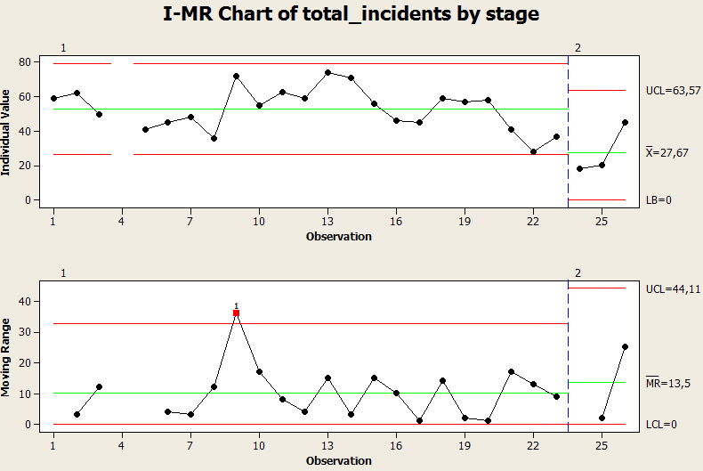
Control Chart for Y (Before – After)
D
M
A
I
C
Variances are not different. However with only 3 points it´s fine!
Two-sample T for total_incidents
stage N Mean StDev SE Mean
1 22 52,8 12,2 2,6
2 3 27,7 15,0 8,7
Difference = mu (1) - mu (2)
Estimate for difference: 25,15
95% CI for difference: (9,25; 41,06)
T-Test of difference = 0 (vs not =): T-Value = 3,27 P-Value = 0,003 DF = 23
Both use Pooled StDev = 12,4934
One-Sample T: total_incidents
Test of mu = 45 vs not = 45 (i.e worst new value)
Variable N Mean StDev SE Mean 95% CI T P
total_incidents 22 52,82 12,22 2,61 (47,40; 58,24) 3,00 0,007
Means are different!
Notes:
Content Slide: This is usually the most frequently used slide in every presentation.
Use this slide for Text heavy slides. Text can only be used in bullet points
Title Heading – font size 30, Arial bold
Slide Content – Should not reduce beyond Arial font 16
If you need to use sub bullets please use the indent buttons located next to the bullets buttons in the tool bar and this will automatically provide you with the second, third, fourth & fifth level bullet styles and font sizes
Please note you can also press the tab key to create the different levels of bulleted content

Slide 37
Validation of Improvements
D
M
A
I
C
Statistical Validation of Improved process
# SR’s raised as Incidents has reduced in more than 50%
# Recurrent Incidents has reduced in more than 75%
# Data issue has reduced in more than 75%
2-t test for Mean
F-test/Levene’s Test for Variation
Sigma Multiple comparison
DPMO comparison
Refer to next 2 steps, as well as “Before and After Summary” slide, with capability analysis and improvement rates
Notes:
Content Slide: This is usually the most frequently used slide in every presentation.
Use this slide for Text heavy slides. Text can only be used in bullet points
Title Heading – font size 30, Arial bold
Slide Content – Should not reduce beyond Arial font 16
If you need to use sub bullets please use the indent buttons located next to the bullets buttons in the tool bar and this will automatically provide you with the second, third, fourth & fifth level bullet styles and font sizes
Please note you can also press the tab key to create the different levels of bulleted content

Slide 38
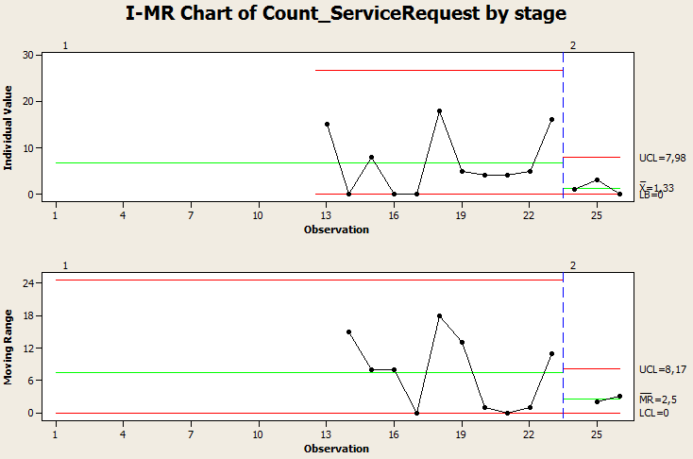
Control Chart for x1 (Before – After)
D
M
A
I
C
X1-Service Requests
Variances are not different. However with only 3 points it´s fine!
Means are different!
Two-Sample T-Test and CI: Count_ServiceRequest; stage
Two-sample T for Count_ServiceRequest
stage N Mean StDev SE Mean
1 11 6,82 6,63 2,0
2 3 1,33 1,53 0,88
Difference = mu (1) - mu (2)
Estimate for difference: 5,48
95% CI for difference: (0,68; 10,29)
T-Test of difference = 0 (vs not =): T-Value = 2,51 P-Value = 0,029 DF = 11
One-Sample T: Count_ServiceRequest
Test of mu = 3 vs not = 3 (i.e. worst “new” value)
Variable N Mean StDev SE Mean 95% CI T P
Count_ServiceRequest 11 6,82 6,63 2,00 (2,36; 11,27) 1,91 0,085
Notes:
Content Slide: This is usually the most frequently used slide in every presentation.
Use this slide for Text heavy slides. Text can only be used in bullet points
Title Heading – font size 30, Arial bold
Slide Content – Should not reduce beyond Arial font 16
If you need to use sub bullets please use the indent buttons located next to the bullets buttons in the tool bar and this will automatically provide you with the second, third, fourth & fifth level bullet styles and font sizes
Please note you can also press the tab key to create the different levels of bulleted content

Slide 39
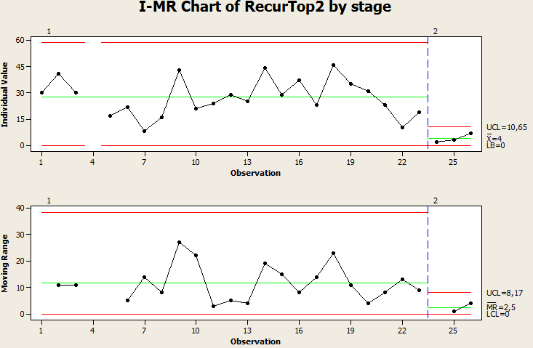
Control Chart for x2 (Before – After)
D
M
A
I
C
X2-Recurrent tickets
Variances are not different. However with only 3 points it´s fine!
Means are different!
Two-Sample T-Test and CI: RecurTop2; stage
Two-sample T for RecurTop2
stage N Mean StDev SE Mean
1 22 27,4 10,6 2,3
2 3 4,00 2,65 1,5
Difference = mu (1) - mu (2)
Estimate for difference: 23,41
95% CI for difference: (17,53; 29,29)
T-Test of difference = 0 (vs not =): T-Value = 8,60 P-Value = 0,000 DF = 13
One-Sample T: RecurTop2
Test of mu = 7 vs not = 7 (i.e worst “new” value)
Variable N Mean StDev SE Mean 95% CI T P
RecurTop2 22 27,41 10,57 2,25 (22,72; 32,09) 9,06 0,000
Notes:
Content Slide: This is usually the most frequently used slide in every presentation.
Use this slide for Text heavy slides. Text can only be used in bullet points
Title Heading – font size 30, Arial bold
Slide Content – Should not reduce beyond Arial font 16
If you need to use sub bullets please use the indent buttons located next to the bullets buttons in the tool bar and this will automatically provide you with the second, third, fourth & fifth level bullet styles and font sizes
Please note you can also press the tab key to create the different levels of bulleted content

Slide 40
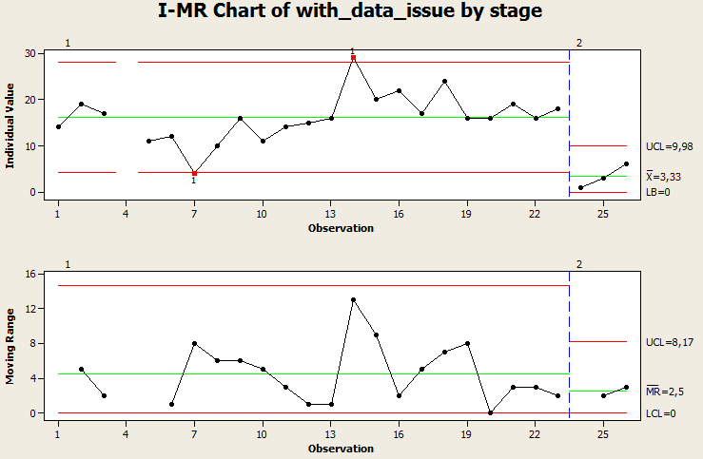
Control Chart for x3 (Before – After)
D
M
A
I
C
X3-ticket with data issues
Variances are not different. However with only 3 points it´s fine!
Means are different!
Two-Sample T-Test and CI: with_data_issue; stage
Two-sample T for with_data_issue
stage N Mean StDev SE Mean
1 22 16,18 5,18 1,1
2 3 3,33 2,52 1,5
Difference = mu (1) - mu (2)
Estimate for difference: 12,85
95% CI for difference: (7,78; 17,92)
T-Test of difference = 0 (vs not =): T-Value = 7,04 P-Value = 0,002 DF = 4
One-Sample T: with_data_issue
Test of mu = 6 vs not = 6 (i.e. worst “new” value)
Variable N Mean StDev SE Mean 95% CI T P
with_data_issue 22 16,18 5,18 1,10 (13,89; 18,48) 9,22 0,000
Notes:
Content Slide: This is usually the most frequently used slide in every presentation.
Use this slide for Text heavy slides. Text can only be used in bullet points
Title Heading – font size 30, Arial bold
Slide Content – Should not reduce beyond Arial font 16
If you need to use sub bullets please use the indent buttons located next to the bullets buttons in the tool bar and this will automatically provide you with the second, third, fourth & fifth level bullet styles and font sizes
Please note you can also press the tab key to create the different levels of bulleted content

Slide 41
Process Controls
D
M
A
I
C
Root Cause | Operating Limits | Counter Measures | Sustenance Plan | Sustenance Owner
X1 | less than 2 | # SR’s raised as incidents in topdesk per month | Return to users that raised those incidents and explain the correct procedure to open SR’s. Update tickets to the correct setup. | Wipro project team
 | (2 to 5) | # SR’s raised as incidents in topdesk per month | Mitigate root causes and provide clarification to the users that are raising incorrect incidents. Don’t work on it before correct setup. | Wipro project team
 | more than 5 | # SR’s raised as incidents in topdesk per month | Request training session to customer users and Wipro team. | Wipro project team
X2 | less than 4 | # Recurrent incidents per month | Check for the distinct occurrences and validate the KEBD. Close the Incident and open a problem in order to find the finally RCA. | Wipro project team
 | (4 to 8) | # Recurrent incidents per month | Have a Problem team in order to find the RCA and fix it. Don´t forget to update The KEBD | Wipro project team
 | more than 10 | # Recurrent incidents per month | Focus on Problem management. Check if Problems are not being closed (old problems). We also suggest for auditing 15 tickets and ensure adequacy of KEBD solution | Wipro project team
X3 | less than 4 | # Data incidents per month | Identify the top type/reason of data issues that have been raised and assign the top issue to the PM to fix in 2 – 3 days (workaround or not) | Wipro project team
 | (4 to 8) | # Data incidents per month | Implement automatic process to detect inconsistencies data between systems or if any recent change is causing the data issues | Wipro project team
 | more than 10 | # Data incidents per month | Implement automatic process (referred in slide 43) | Wipro project team
Notes:
Content Slide: This is usually the most frequently used slide in every presentation.
Use this slide for Text heavy slides. Text can only be used in bullet points
Title Heading – font size 30, Arial bold
Slide Content – Should not reduce beyond Arial font 16
If you need to use sub bullets please use the indent buttons located next to the bullets buttons in the tool bar and this will automatically provide you with the second, third, fourth & fifth level bullet styles and font sizes
Please note you can also press the tab key to create the different levels of bulleted content

Slide 42
more than 10 | # Recurrent incidents per month | Analyse problem management service. Check if Problems are not being closed… | Wipro project team | need a more objective reaction plan. For example, you can suggest for auditing 15 tickets and ensure adequacy of KB solution
less than 4 | # Data incidents per month | Analyse the type/reason of data issues that have been raised | Wipro project team | ‘analyze’ is generic word. You can suggest what analysis to do. For example, it can be a “top issue identifier” and assign the top issue to the PM to fix in 2 – 3 days
(4 to 8) | # Data incidents per month | Check if Wipro can implement any automatic process to process data issues or if any change is causing the data issues. | Wipro project team | What kind of automation do you recommend. Are you referring to some quick fixes like ‘auto hot keys’ or ‘batch processing’ etc ?
more than 10 | # Data incidents per month | Check if Wipro can implement any automatic process to process data issues or if any change is causing the data issues. | Wipro project team | What kind of automation do you recommend. Are you referring to some quick fixes like ‘auto hot keys’ or ‘batch processing’ etc ?

Slide 43
Process Controls
D
M
A
I
C
Any mistake-proofing done
Create new tools to prevent direct database manipulation
Price/Clearance Change Upload tool -> Customer request several times to upload massive price changes or clearances through RPM. This process is formed by some steps to validate data and also to run batch process. Wipro built an automatic java process that execute internally all the steps in sequence (including the data format data).
Replenishment Query -> Every day Wipro executed in the end of RMS ORACLE batch a group of steps to allow the customer start the WH day. This was a manual action and some days occurred some delays and errors. Therefore Wipro implemented an automatic process to execute these steps using the scheduler batch tool. With this implementation was removed all the manual actions.
Validate format date before introduce data in the system
Helpdesk tool optimized
SOP’s for new process / settings
New SR’s status Daily check
Monthly analysis of recurrent incidents vs Pending/solved problems
Identify the data issue source in a weekly base.
Process owner identified for sustenance
Weekly Incident team meeting
Monthly meeting with customer to analyze incidents/SR’s and problems
Any open action items
N/A
Notes:
Content Slide: This is usually the most frequently used slide in every presentation.
Use this slide for Text heavy slides. Text can only be used in bullet points
Title Heading – font size 30, Arial bold
Slide Content – Should not reduce beyond Arial font 16
If you need to use sub bullets please use the indent buttons located next to the bullets buttons in the tool bar and this will automatically provide you with the second, third, fourth & fifth level bullet styles and font sizes
Please note you can also press the tab key to create the different levels of bulleted content

Slide 44
Before and After Summary
D
M
A
I
C
 | Process Sigma | CTQ (Y) | X1 | X2 | X3
Baseline (Before) | Sigma level = 1.2 (rounded) / Cp, Cpk= -0.11 | mean=52.18 control limits (26.36; 79.28) | Mean=6.82 control limits (0; 26.76) | Mean=27.41 control limits (-3.71; 58.53) | Mean=16.18 control limits (4.21; 28.15)
Target | Sigma level = 3 / Cp, Cpk = 1 | (reduce 25%) mean=40.0 specification limits= (0.0; 50.0) | Tolerance values between 0 and 6 | tolerance values between 10 and 20 | tolerance values between 5 and 20
Post Improvement (After) | Sigma level = 2 (rounded) / Cp, Cpk= 0.62 | Mean=27,67 control limits (0; 63.57) | Mean=1.33 control limits (0; 7.98) | Mean=4 control limits (0; 10.65) | Mean=3.33 control limits (0; 9.98)
% Improvement Vs Baseline | 66,67% of improvement | 48,88% improvement of mean; Means statistically are different; Current mean lower than target mean | 80,5% improvement of mean; Means statistically are different; Current mean lower than baselined mean | 85,40% improvement of mean; Means statistically are different; Current mean lower than baselined mean | 79,6% improvement of mean; Means statistically are different; Current mean lower than baselined mean
Notes:
Content Slide: This is usually the most frequently used slide in every presentation.
Use this slide for Text heavy slides. Text can only be used in bullet points
Title Heading – font size 30, Arial bold
Slide Content – Should not reduce beyond Arial font 16
If you need to use sub bullets please use the indent buttons located next to the bullets buttons in the tool bar and this will automatically provide you with the second, third, fourth & fifth level bullet styles and font sizes
Please note you can also press the tab key to create the different levels of bulleted content

Slide 45
Institutionalization
D
M
A
I
C
What are the learning's from this project
It is always possible to change and improve. We only need to put some dedication and find the best practices and procedures.
The project management tools could be reviewed in order to check if they can be improved and facilitate the project team work.
With cooperation of all it is possible to do optimizations inside of the team.
Always be proactive, don´t waiting for the problems, anticipate to them
Be assertive and focus on one by one issue.
What are the replication plans?
Other projects can follow the same improvements done during this 6 sigma project.
Go forward to the fishbone analysis and do it step by step
Who else (domain) can use the learning's from this project
Other ASM project in other accounts (PT and INDIA)
Notes:
Content Slide: This is usually the most frequently used slide in every presentation.
Use this slide for Text heavy slides. Text can only be used in bullet points
Title Heading – font size 30, Arial bold
Slide Content – Should not reduce beyond Arial font 16
If you need to use sub bullets please use the indent buttons located next to the bullets buttons in the tool bar and this will automatically provide you with the second, third, fourth & fifth level bullet styles and font sizes
Please note you can also press the tab key to create the different levels of bulleted content

Slide 46
Project Benefits
D
M
A
I
C
What Business Metric Improved?
Clear distinction between SR’s and Incidents in the TopDesk tool
Reduction of recurrent incidents
What Customer Metric Improved?
Contract value reduction
Reduction of new incidents
What Project Metric Improved?
Reduction of overall incidents
Reduction of project costs
Project team optimization
Financial Benefits along with BFM/Finance team approval
On-call service costs reduced in around 35%.
Team available to work on new CR’s.
Actions | Before | After | Annualized savings
On call Optimization (Monthly average) | $5.145,54 | $2.783,80 | $28340,88
# Incidents Work (Monthly average) | 52,52 | 27,6
Incidents Work costs (Monthly average) | $4.569,24 | $2.401,20 | $26016,48
total |  |  | $54357,36
Notes:
Content Slide: This is usually the most frequently used slide in every presentation.
Use this slide for Text heavy slides. Text can only be used in bullet points
Title Heading – font size 30, Arial bold
Slide Content – Should not reduce beyond Arial font 16
If you need to use sub bullets please use the indent buttons located next to the bullets buttons in the tool bar and this will automatically provide you with the second, third, fourth & fifth level bullet styles and font sizes
Please note you can also press the tab key to create the different levels of bulleted content

Slide 47
Customer Commendations
D
M
A
I
C
Attach Customer commendations if any…
…not all solutions have been delivered yet, but progress is showing…
Most requests and queries are addressed quickly…
Progress on resolving incidents and operational issues is satisfying…
Notes:
Content Slide: This is usually the most frequently used slide in every presentation.
Use this slide for Text heavy slides. Text can only be used in bullet points
Title Heading – font size 30, Arial bold
Slide Content – Should not reduce beyond Arial font 16
If you need to use sub bullets please use the indent buttons located next to the bullets buttons in the tool bar and this will automatically provide you with the second, third, fourth & fifth level bullet styles and font sizes
Please note you can also press the tab key to create the different levels of bulleted content

Slide 48
Control Phase Check Points
D
M
A
I
C
All Improvements of Y and X’s are statistically validated
Process post improvement shall be in statistical control, All the X’s that were improved are under control and are no additional factors impacting the project CTQs.
Before and After Control charts are prepared for Y and all critical X’s
Before and After process capability (Sigma level) is computed
Control plan is prepared covering the critical failure modes, Critical X’s and their tolerances, is devised for all factors that impact project CTQ.
Control plan includes corrective and preventive steps if the process were to go out of control along with action owners.
Notes:
Content Slide: This is usually the most frequently used slide in every presentation.
Use this slide for Text heavy slides. Text can only be used in bullet points
Title Heading – font size 30, Arial bold
Slide Content – Should not reduce beyond Arial font 16
If you need to use sub bullets please use the indent buttons located next to the bullets buttons in the tool bar and this will automatically provide you with the second, third, fourth & fifth level bullet styles and font sizes
Please note you can also press the tab key to create the different levels of bulleted content

Slide 49
Project Summary for Internal Publishing
Project Brief
Client: WE Fashion Scope of engagement: ORACLE RETAIL ASM SUPPORT Project Scope: Reduce total number of incidents per month in Oracle Retail application support + DBA technical support
Business and Technical Challenge
Business Case: "Currently are being raised in average 55 incidents per month and we are proposing to reduce this value in 25%.This could reduce the operation service value in 25%. This reduction (potentially) could represent a 1.5K EU per month." Project CTQ: Reduce 25% total incident raised in average/month
Analysis
Methodology adapted: DMAIC and statistical tools like linear regression Statistical baseline and target control charts Identification of vital Xs using the team brainstorming and also the feedback received from customer Prioritized X’s: Service Requests raised on TopDesk tool as Incidents Recurrent Incidents Invalid data from other systems or user mistakes
Improve actions
Problem Management HelpDesk Tool optimization
Control Plan
Check number of new incidents vs SR’s Wipro costs for on-call services / team availability to solve problems and analyse CR’s
Description | Before | After
Process Sigma Value | Sigma level = 1.2 (rounded) / Cp, Cpk= -0.11 | Sigma level = 2 (rounded) / Cp, Cpk= 0.62 [66,67% of improvement]
CTQ (Y) | mean=52.18 control limits (26.36; 79.28) | Mean=27,67 control limits (0; 63.57) [48,88% improvement of mean; Means statistically are different; Current mean lower than target mean]
Benefits
Reduction of Incidents Reduction of Wipro costs
Notes:
Content Slide: This is usually the most frequently used slide in every presentation.
Use this slide for Text heavy slides. Text can only be used in bullet points
Title Heading – font size 30, Arial bold
Slide Content – Should not reduce beyond Arial font 16
If you need to use sub bullets please use the indent buttons located next to the bullets buttons in the tool bar and this will automatically provide you with the second, third, fourth & fifth level bullet styles and font sizes
Please note you can also press the tab key to create the different levels of bulleted content

Slide 50
Thank You – Journey will continue
Emilia Soares
Arthur Valle
João Morais
Notes:
Thank you slide with the customer logo:
Should have only the details shown here. Logo placement cannot be changed. Wipro logo to appear on the left as per our corporate guidelines.
Thank you– font size 30, Arial Bold
Name & Designation – font size 18, Arial normal, not to exceed beyond 2 lines
Your/contact email id – font size 18, Arial normal

